Slide 1

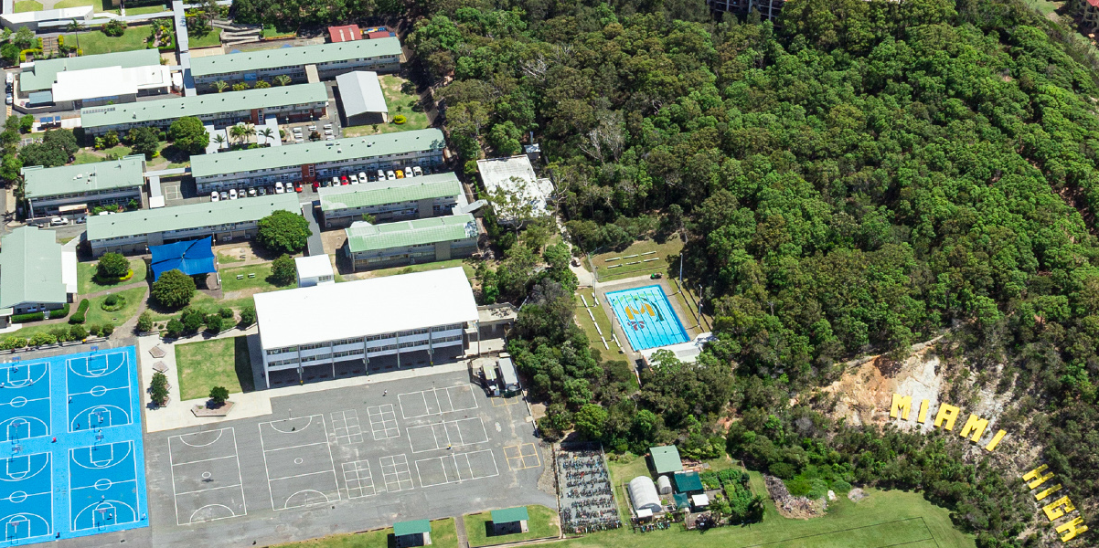
Year 11 (2027)
Pathways Evening
2026
Notes:
Clint

Slide 2

Acknowledgement of Country
Miami State High School would like to acknowledge the traditional custodians of this land, the Kombumerri Saltwater People and the land on which we meet.
We would like to acknowledge the Aboriginal and Torres Strait Islander people in our school and the First Nations peoples of other countries who call Miami High home.
We pay our respects to the Elders who hold our stories and the stories of the Kombumerri Saltwater people. The Elders pass down our culture. For without our Elders we wouldn’t have our connection to country, tradition and language.
Miami High School is the site of great significance for the Kombumerri Saltwater people. It is a place of connection through the land, the water, and animals.
We pay our respects to all Elders, past, present and emerging.
Magic Mountain by Claire White
I am Magic Mountain and I have always been. I watch over my sky and my sea and my lands. My people have always been and I watch and protect them. They care for me and my sky and my sea and my lands and they watch and protect me. My women people give life to young people at another mountain and I watch and protect them. My men people must not watch my women people give life but they must grow young men people to be men people and I watch and protect them. My people walk my lands and I watch and protect them. My people then rest and I watch and protect them. I am Magic Mountain and I have always been.
Notes:
Clint, then handover to Karla

Slide 3
Senior School Team
Mr Jason Cross – Deputy Principal (jcros40@eq.edu.au)
Mrs Ellenor Voysey - HOD Senior School (evoys3@eq.edu.au)
Mr Josh Atkins - Senior Guidance Officer (jatki94@eq.edu.au)
Mrs Yvette Fitzpatrick - Industry and Vocational Training Officer
(yfitz0@eq.edu.au)
Mr AJ Dawson – Dean of Students (adaws116@eq.edu.au)
Notes:
Karla

Slide 4
Year 12 Success (2025)
62% achieved a VET qualification (Cert I, II, III, IV and Diploma)
4 students achieved perfect subject scores of 100/100
7 students achieved perfect external exam scores
14/23 General Subjects had a median score above that of the State
10/23 General Subjects had a higher percentage of A’s than the State
40% of ATAR eligible students achieved and ATAR higher than 80
Notes:
Karla + handover to Elle

Slide 5
Success in Senior School
Every Year 12 student will exit with their QCE or QCIA, as well as at least one of the following:
  A competitive ATAR score
  A Nationally recognised qualification (CI, II, III, IV or Diploma)
  A successful transition to 'Year 13’
To make this possible:
Huge variety of curriculum and VET offerings
Access to external education courses, traineeships and apprenticeships
Individual student tracking and personalised approach to student pathways
Access to support staff (HOD Senior School, GO, ILO, Dean of Students)
Notes:
Karla + handover to Elle

Slide 6
Student Expectations and
School Code of Conduct
Year 11 is the commencement of the compulsory participation phase of schooling.
Attendance is a key indicator for success and students should aim to meet the school target of 88%
Engaged in all lessons, complete all class work and submit all assessment items by the due date
Follow the expectations of all senior students as outlined in the Student Code of Conduct
Support, Intervention and At Risk of Enrolment Cancellation meetings
Notes:
Karla

Slide 7
Types of Senior Subjects
General | Applied | VET qualifications
Designed to prepare students for university Academically rigorous | Focus on practical skills Lead to vocational education | Certificates, diplomas, traineeships, apprenticeships Lead to further study at TAFE, uni or work
3 internal assessments 1 external assessment Final mark out of 100 Most subjects – external exam is worth 25% of a student’s grade Maths and Science subjects – external exam contributes 50% to grade | Graded on an A to E scale 4 internal assessments completed across Units 3 and 4 | Competency based Pass/fail Many use VETiS funding, some are fee for service The higher the qualification, the more academically rigorous
Eg. English, General Maths, Music, Physical Education, Economics, Modern History | Eg. Essential English, Essential Maths, Sport and Recreation, Business Studies | Eg. Cert II Construction, Cert III Fitness, Diploma of Business
Notes:
Elle – start with terminology

Slide 8
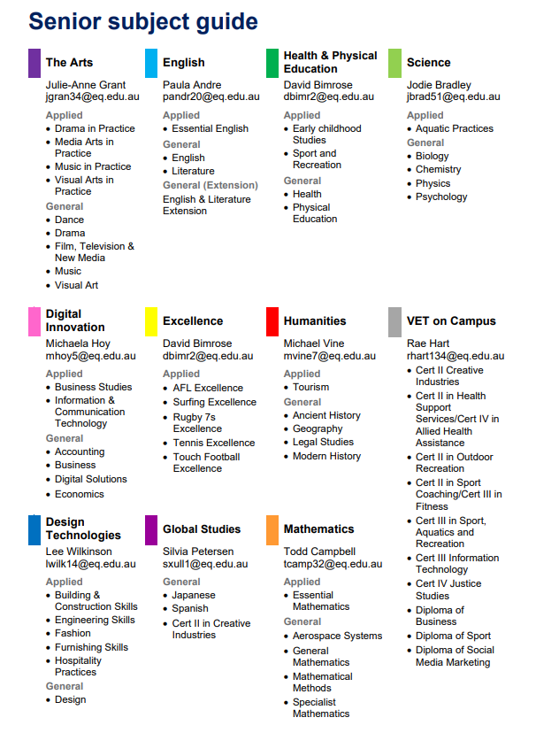
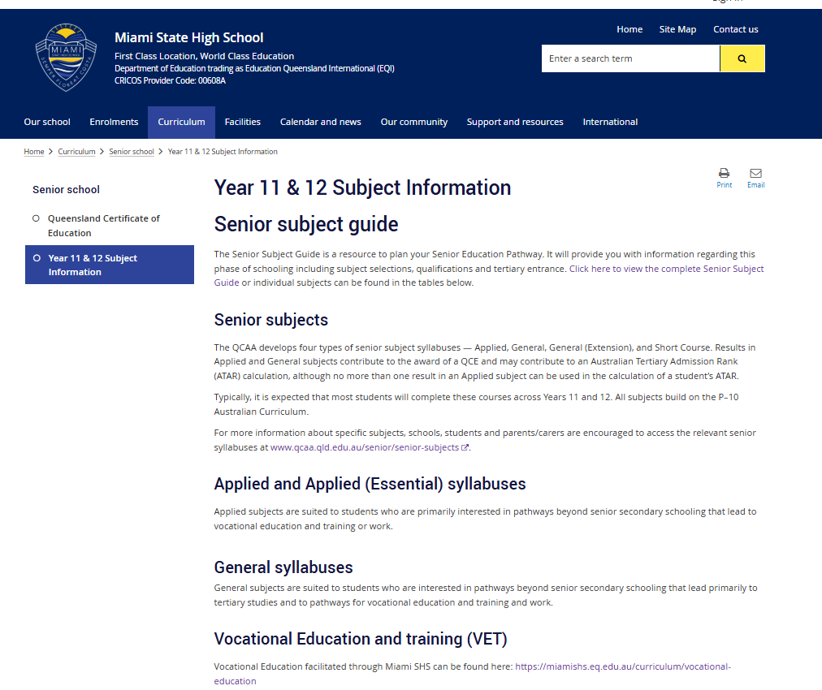
Senior Subjects
Notes:
Elle

Slide 9
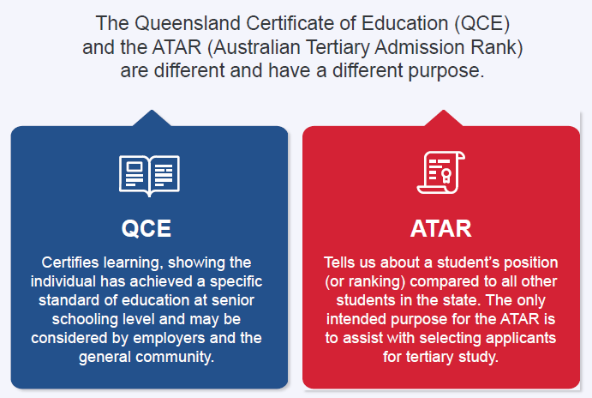
QCE vs ATAR
Notes:
Elle

Slide 10
Senior Timelines
Each subject is comprised of 4 units of work
Year 11 |  |  |  | Year 12
Term 1 | Term 2 |  | Term 3 | Term 4 | Term 1 | Term 2 | Term 3 | Term 4
Unit 1 15 weeks |  | Unit 2 15 weeks |  | Units 3 and 4
Formative/Preparatory work Between 2 and 4 pieces of assessment per subject Results count for QCE |  |  |  | Summative work 4 pieces of assessment per subject Results count for QCE and ATAR (if eligible) |  |  |  | External Exams for General subjects
Notes:
Elle

Slide 11
QCE – Accruing Credits
Minimum 20 credits required across Year 11 and 12
Can be banked from:
1.Passing subjects - one QCE credit per unit per subject (each subject has 4 units)
2.Doing Certificate courses (e.g. traineeships, apprenticeships)
Must pass one unit of English and one unit of Maths.

Slide 12
QCE – Avoiding Trouble
Students that fall into our ‘at risk’ category have usually done one of the following:
Multiple subject changes – this can affect the “completed core” component of QCE
Not passing subjects, especially in Year 11
Attendance / engagement
For students on a Flexible pathway, not supplementing school subjects with certificate courses

Slide 13
What is an ATAR?
A number QTAC uses to decide which Year 12 school leavers are offered a place at University.
A number on a 2000 point scale from 99.95 to 0.00 in increments of 0.05
Designed to be a predictor of first year performance at university.
Has a ‘lifespan’ of about 3 months after school
99.95
approx. 30
QLD students
99.90
approx. 30
QLD students
99.85
approx. 30
QLD students
99.80
approx. 30
QLD students
30.00

Slide 14
Should your student be on an ATAR Pathway?
An ATAR of about 60 is the bare minimum to secure a place at university.
Students need to be achieving As and/or Bs in General subjects (better than 65%)
This is the reason for our Readiness Criteria (found in your pack)
The work in General Subjects is a lot harder in Year 11, and there is more of it.
It is not unusual for a student’s results to drop by a whole grade in Year 11
Studying for an ATAR is not a ‘back-up’ plan – it needs to be the focus

Slide 15
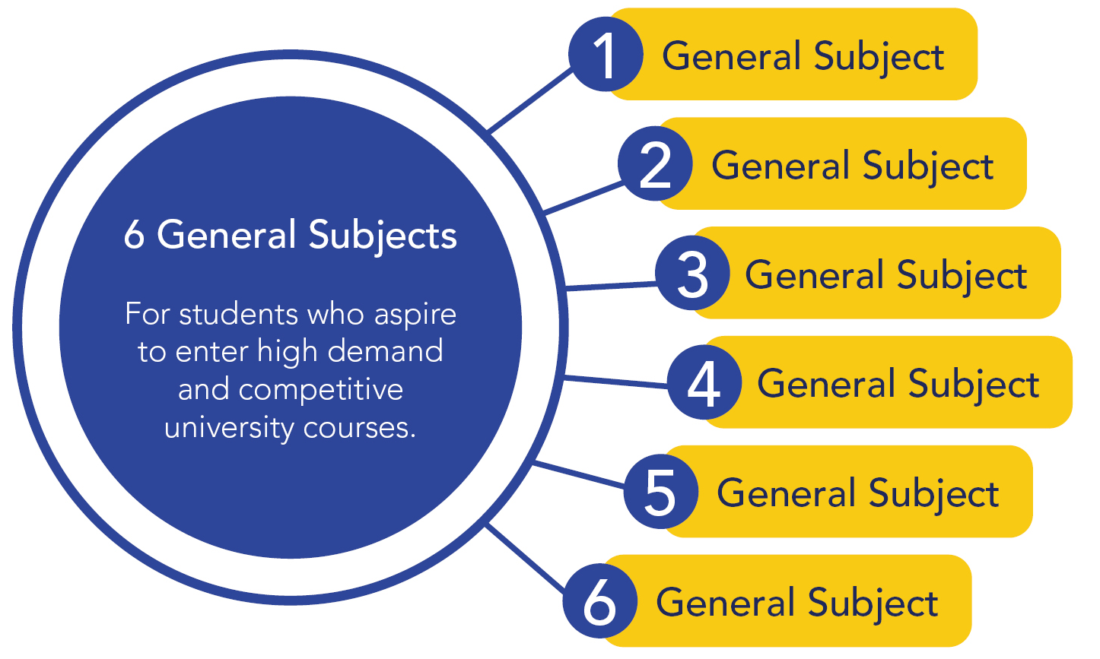
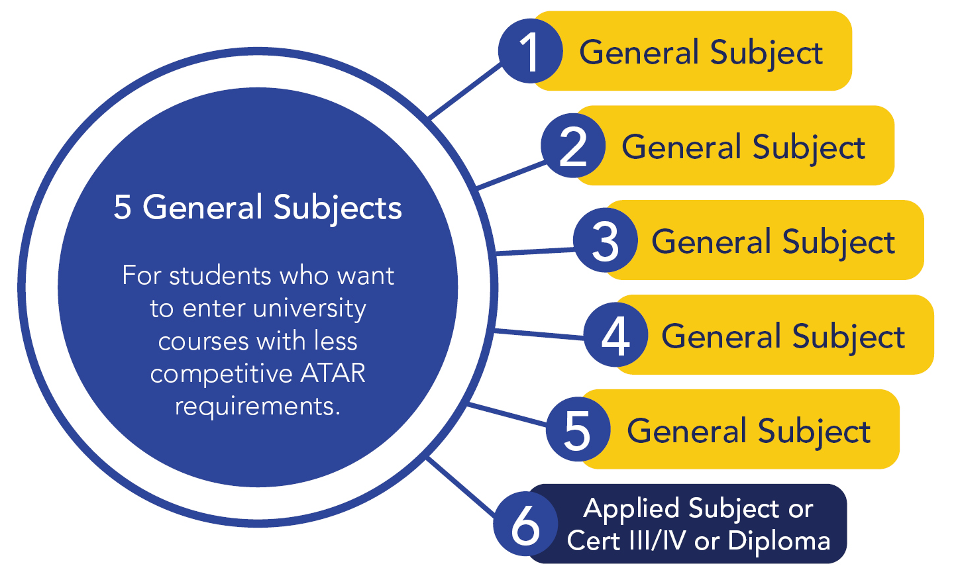
ATAR Pathways
ATAR Pathway 1
ATAR Pathway 2

Slide 16
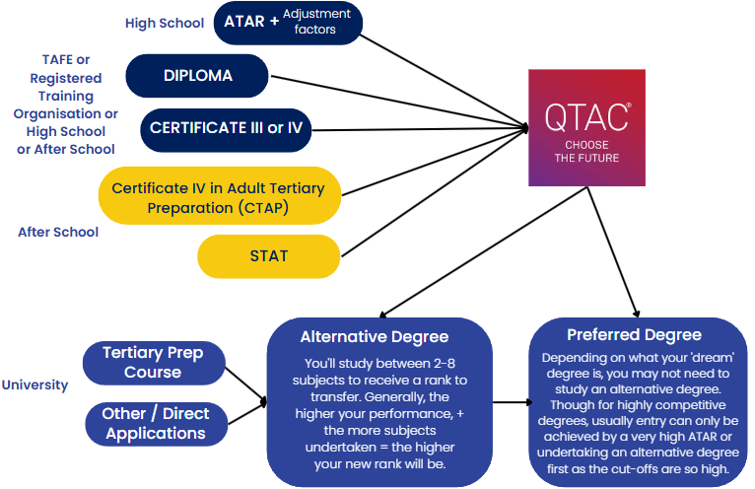
Pathways to University

Slide 17
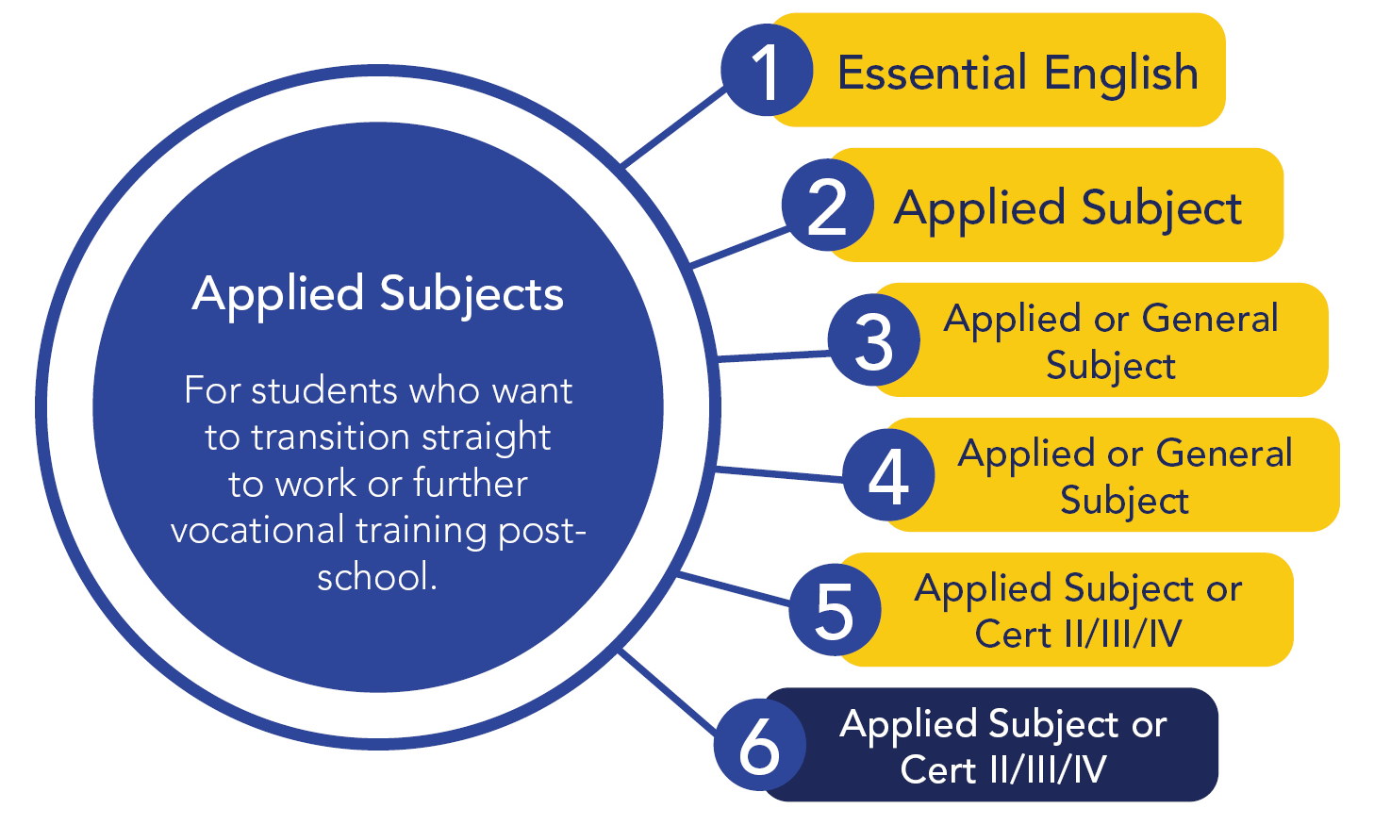
Flexible Pathway
Notes:
Elle – handover to Yvette

Slide 18
VET Qualifications
Internal qualifications – delivered at school as a subject in the timetable. Certificate III or higher have a cost involved.
Qualification | RTO
Certificate II in Sport Coaching + Certificate III in Fitness | GeSS Education. Delivered by trainer. (partly VETiS funded)
Certificate III in Sport, Aquatics and Recreation | IVET. Delivered by a PE staff member
Certificate III in Information Technology | IVET. Delivered by Mr Pellin
Certificate IV in Justice studies | Professional Investigators College of Australasia (PICA). Independent work.
Diploma of Business | GeSS Education. Delivered by trainer.
Diploma of Sport (Coaching and Sport Development) | GeSS Education. Delivered by trainer.

Slide 19
VET Qualifications
External qualifications
Pre-apprenticeship courses in Trades, Hospitality, Hairdressing plus a huge range of Certificate Courses in Fashion, Nursing, Make-up, Information Technology, Music, Art, Horticulture, Design, Aged Care, Animal Studies, and more
School Based Traineeships & Apprenticeships (Certificate III)
Students gain a valuable qualification while working part-time.
Certificate III Business / Hospitality / Retail / Trade apprenticeships
Certificate III or higher qualifications may give direct entry to university opportunities without the need for an ATAR
Many require students to miss a day of school - if doing General Subjects this is very hard to manage

Slide 20
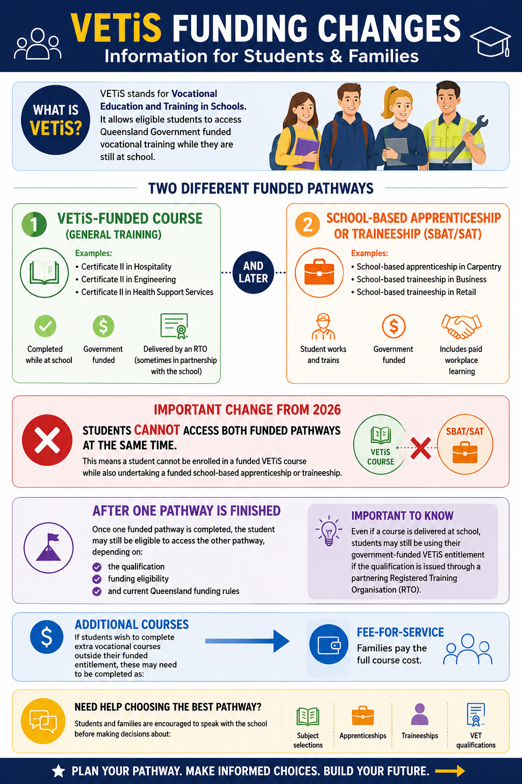
VETiS Funding
VETiS = Vocational Education and Training in Schools
Cert II courses funded by the Qld government
Every student over 15 has access to 1 free VETiS funded Cert II course while at school

Slide 21
Career Guidance
Mr Josh Atkins (jatki94@eq.edu.au) – Guidance Officer
AARA
University Subjects while at school
Alternative Pathways
Notes:
Josh start here

Slide 22
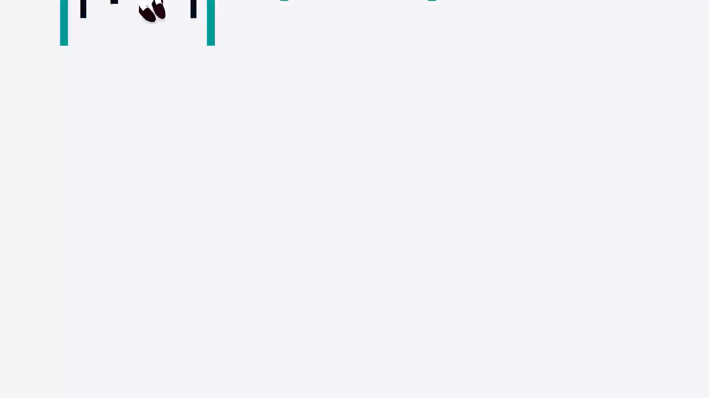
Access Arrangements and
Reasonable Adjustments (AARA)
Every assessment in Yr11 and 12 contributes to QCE.
Assessment conditions are very explicit and monitored by the QCAA.
If a student needs adjustments to access assessment they must apply for AARA with supporting documentation.
Notes:
Josh

Slide 23
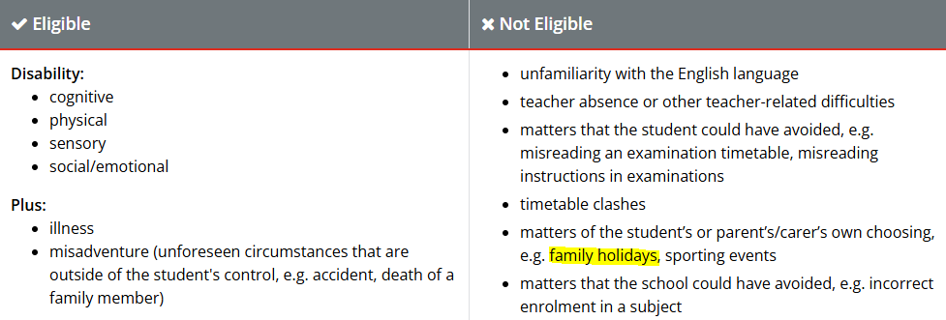
AARA – Will it be Approved?
If AARA is not approved, the student's draft will be marked.
If a student fails an assessment, they could fail the entire Unit and therefore, lose a QCE credit.
Notes:
Josh

Slide 24





Start University Early?
Universities offer students the opportunity to study a first-year subject while at high school.
Potential benefits include:
exemption/discounted tuition fees
credit towards the QCE
credit towards the bachelor degree
guaranteed entry into the bachelor degree
Examples
Bond University - Student For A Semester
Griffith University - Head Start
Southern Cross University - Scholars Program
University of Queensland - Enhances Studies Program
Queensland University of Technology - START QUT
​
Notes:
Josh

Slide 25

Alternative Pathways
More targeted approach to educational outcomes
Still achieve your QCE
Accelerate learning and qualifications
Qualifications can be used to gain entry to further education
Easily combined with part-time work/elite sport/health issues
Examples
TAFE
Full-time Apprenticeship and Traineeship
VLC / MOB / Busy Schools / Distance Education
Notes:
Josh – hand back to Elle

Slide 26
Final Words
DO NOT choose your subjects for the following reasons:
“My friend is taking that subject.” There are usually several classes in a subject, so even if you are doing the same subjects, you won’t necessarily be in the same class.
“I do/don’t really like the teacher.” There is no guarantee that you will have any particular teacher.
“Someone told me that the subject is fun (or easy, or interesting).”
  It may be enjoyable/easy/interesting for someone but not necessarily for you. Make up your own mind based on what you enjoy and are good at.
“Someone told me that the subject is boring.” See point 3.
“Someone told me that I do/don’t need that subject for the course I want to take at university,” or “I think this subject is better for my ATAR.” Check tertiary prerequisites or see a Guidance Officer.
​
Notes:
Elle

Slide 27
Where to from Here?
It is not about knowing exactly what you want to do for the rest of your life, it is about putting a plan in place which is going to best position you for your future.
Speak with 'people in the know'
Investigate any external opportunities that interest you
See your Thrive teacher with any questions
Notes:
Elle

Slide 28
Next Steps
​
Browse the expo tonight and be as informed as possible
Students will complete a series of lessons across Terms 2 and 3 giving them an opportunity to explore potential careers and pathways to how to get there (attendance is critical)
Term 3, Week 6 - Subject Selection Interviews – student and parent will meet with a member of the Senior School team to finalise subject choices

Slide 29
Principal’s Closing Remarks
Notes:
Clint

Slide 30


