Slide 1

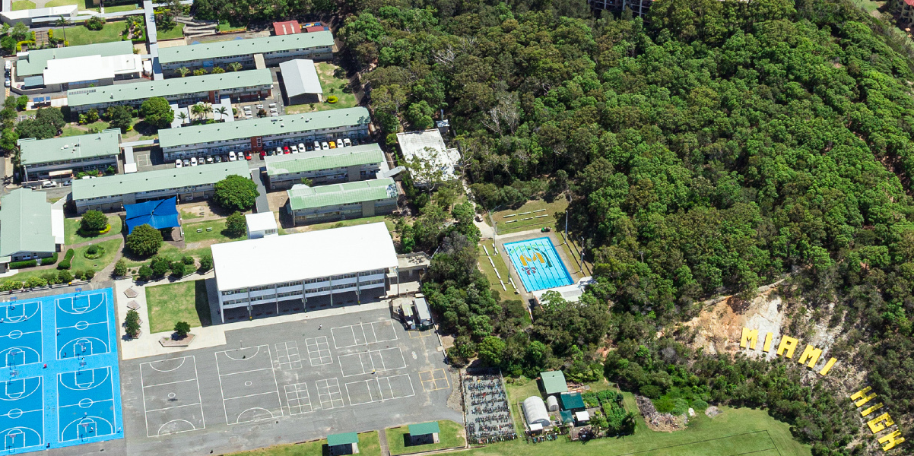
Year 10 (2027)
Pathways Evening
Notes:
Karla to begin

Slide 2

Acknowledgement of Country
Miami State High School would like to acknowledge the traditional custodians of this land, the Kombumerri Saltwater People and the land on which we meet.
We would like to acknowledge the Aboriginal and Torres Strait Islander people in our school and the First Nations peoples of other countries who call Miami High home.
We pay our respects to the Elders who hold our stories and the stories of the Kombumerri Saltwater people. The Elders pass down our culture. For without our Elders we wouldn’t have our connection to country, tradition and language.
Miami High School is the site of great significance for the Kombumerri Saltwater people. It is a place of connection through the land, the water, and animals.
We pay our respects to all Elders, past, present and emerging.
Magic Mountain by Claire White
I am Magic Mountain and I have always been. I watch over my sky and my sea and my lands. My people have always been and I watch and protect them. They care for me and my sky and my sea and my lands and they watch and protect me. My women people give life to young people at another mountain and I watch and protect them. My men people must not watch my women people give life but they must grow young men people to be men people and I watch and protect them. My people walk my lands and I watch and protect them. My people then rest and I watch and protect them. I am Magic Mountain and I have always been.

Slide 3
Welcome
Ms Lieve Rimbaut (Associate Principal)

Slide 4
Introduction
Ms Liz Mahon (Deputy Principal – Year 10)

Slide 5
The Goal of Year 10……….
Year 11 is the commencement of the compulsory participation phase of schooling. Therefore, Year 10 is to set you up for success in Year 11.
Our Goal - By the end of Year 10, every student will:
Try a variety of subjects
Understand the rigour of the different Year 10 subjects offered
Understand the pathways available to them beyond Year 10
Have an identified pathway for Year 11 and beyond

Slide 6
Middle School Team
Deputy Principals: Ms Melissa Donnelly (Yr 9), Ms Liz Mahon (Yr 10)
Head of Department (Middle School): Ms Paula Hamilton
Guidance Officer: Mrs Sarah Nelson
Year 9 Dean of Students: Mr Jakob Dolan
Year 9 Enrichment Teacher: Ms Rachael Hori
Industry and Vocational Education Officer: Ms Yvette Fitzpatrick

Slide 7
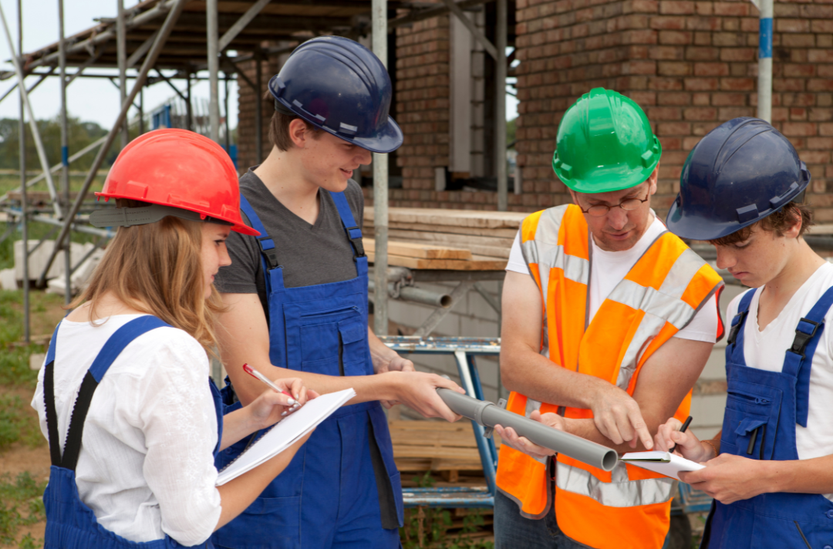
Work Experience
– Real World Learning
Available in Year 10
Attend one day per week for several weeks or a full term
Develop:
  Confidence
  Communication & teamwork skills
  Understanding of workplace expectations
Helps clarify career goals and subject choices
School-supported, student-driven

Slide 8
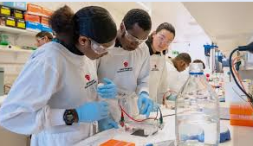
Work Experience
– Real World Learning
Year 9 - Compulsory block towards the end of Term 4
Further information to be released during Term 3
What can you do to get this started?
  Think about what you may want to do
  Approach businesses to take you for this work experience
  Consider family, friend of family, community groups, sporting groups, etc

Slide 9
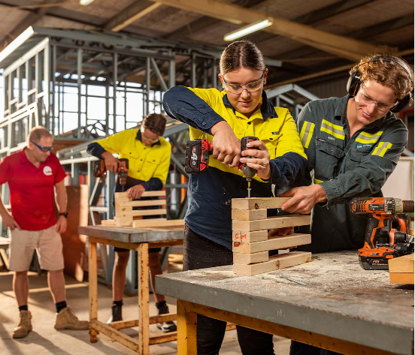
TAFE Taster Program – Year 10
One day per week for one school term
Delivered during school hours at TAFE campuses
Explore industries such as:
  Automotive, Construction, Hair & Beauty, Health, Engineering, Electrotechnology and Hospitality
Free to participate
No commitment – just try and see what fits

Slide 10


Slide 11

Earn, Learn & Get Qualified
Start a nationally recognised qualification (usually Certificate III)
Work part-time and earn a wage while at school
Combine school, training and paid work
Industry-based learning — great for future employment
May involve missing part or a full day of school (depending on industry)

Slide 12



Next Steps & Support Available
Interested in TAFE Tasters, Work Experience or a SAT?
  Speak with Yvette Fitzpatrick (yfitz0@eq.edu.au or 55540374) or visit our school website
Meet RTOs and training providers tonight
Representatives from:
  MAS National
  MEGT
  BUSY at Work
  are available to discuss SATs
Let’s help your student make confident, informed choices for 2027 and beyond

Slide 13
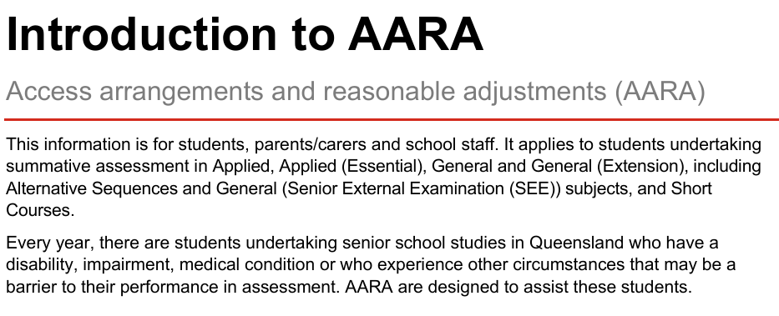

Student Expectations
Attendance is a key indicator for success
  Students should aim to meet the school target of 95%
Engaged in all lessons, complete all class work and
submit all assessment items by the due date
Apply for AARA for any assessment modifications,
early submissions and/or extensions

Slide 14
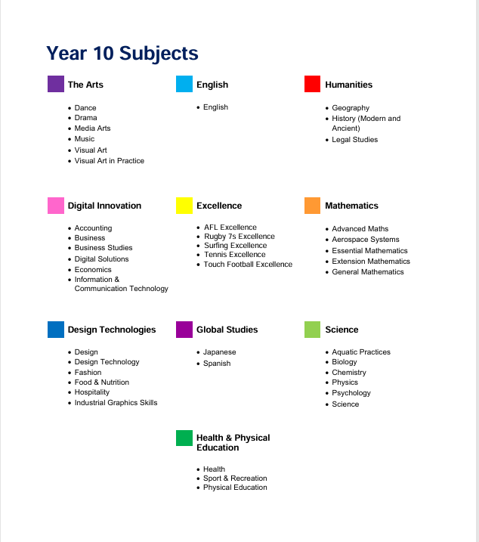
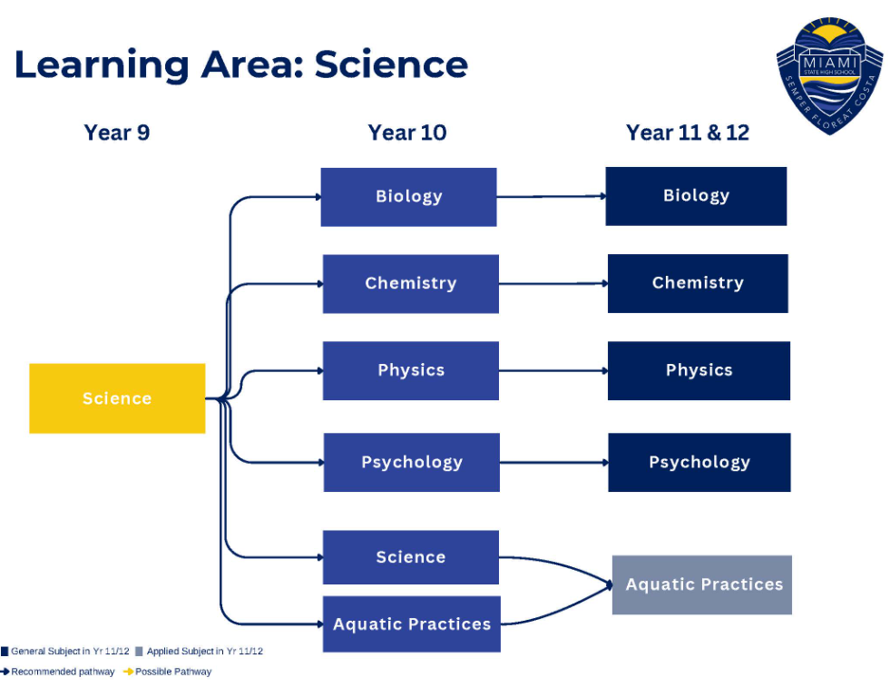
Year 10 Subjects

Slide 15
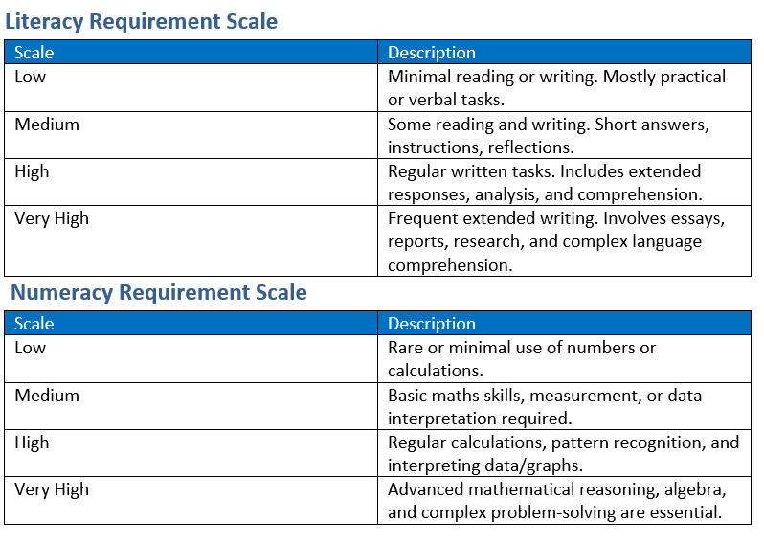

Year 10 Subjects
Literacy and Numeracy Requirements
In Term 3, evaluate your TrackEd Profile – be realistic.

Slide 16
Final Words
​
DO NOT choose your subjects for the following reasons:
“My friend is taking that subject.” There are usually several classes in a subject, so even if you are doing the same subjects, you won’t necessarily be in the same class.
“I do/don’t really like the teacher.” There is no guarantee that you will have any particular teacher.
“Someone told me that the subject is fun (or easy or interesting or boring).” It may be enjoyable/easy/interesting for someone but not necessarily for you. Make up your own mind based on what you enjoy.

Slide 17
Myth: There is a Year 10 Certificate

Slide 18

Late Term 4
Compulsory Year 9 Work Experience.

Slide 19


