Slide 1


Work Experience Program
Test Drive Your Future
Term 4, Week 9 & 10

Slide 2
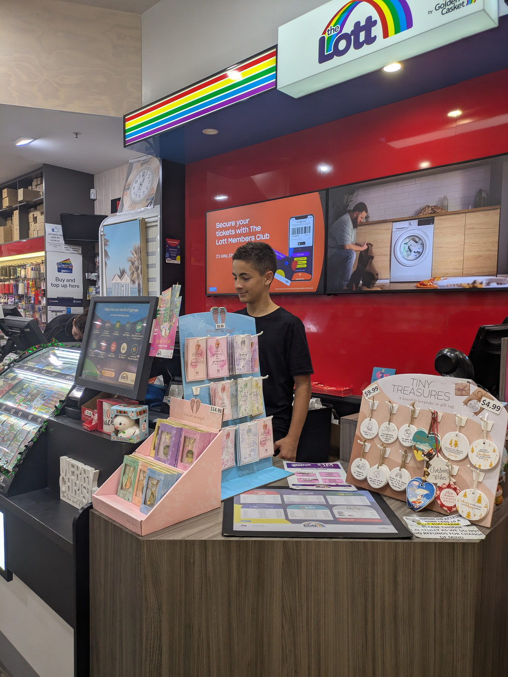
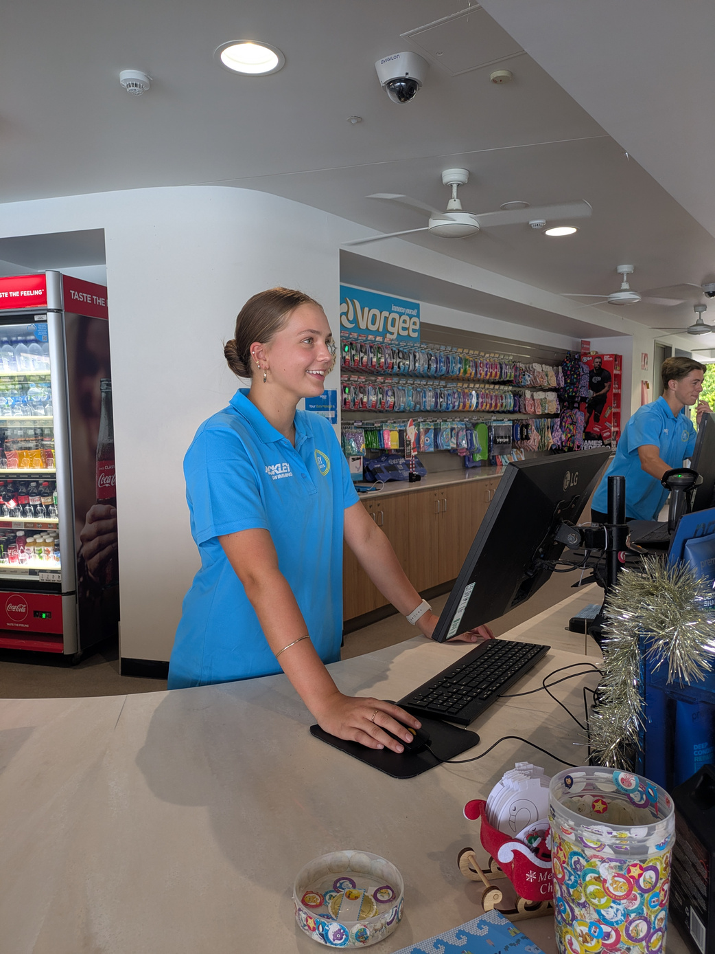
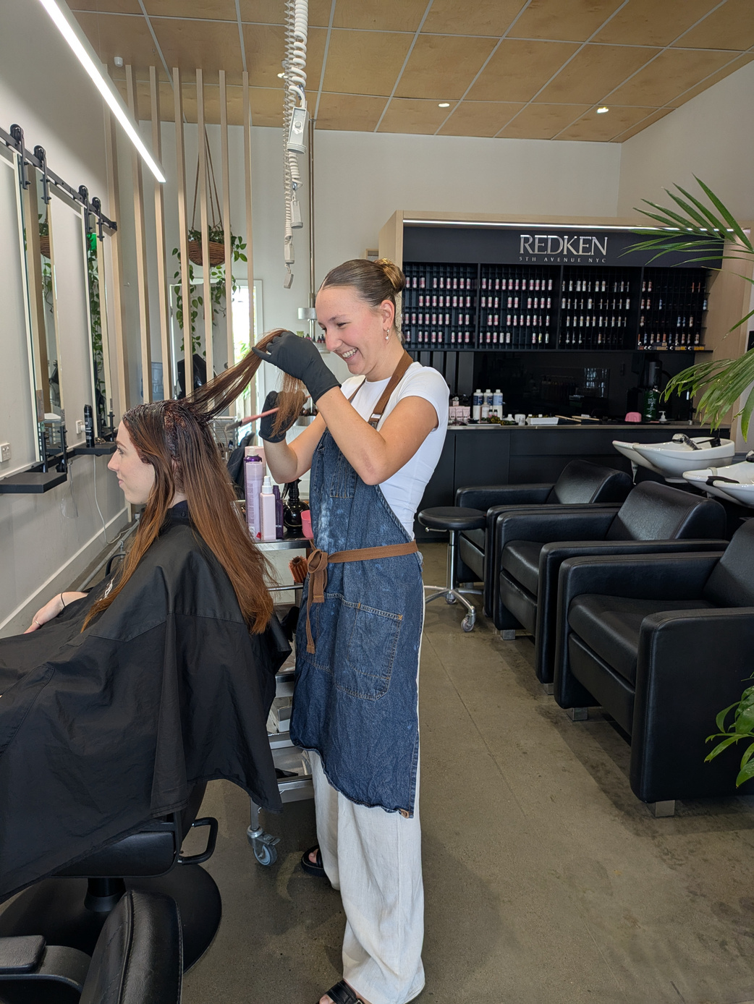
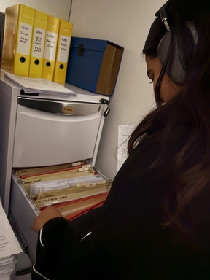
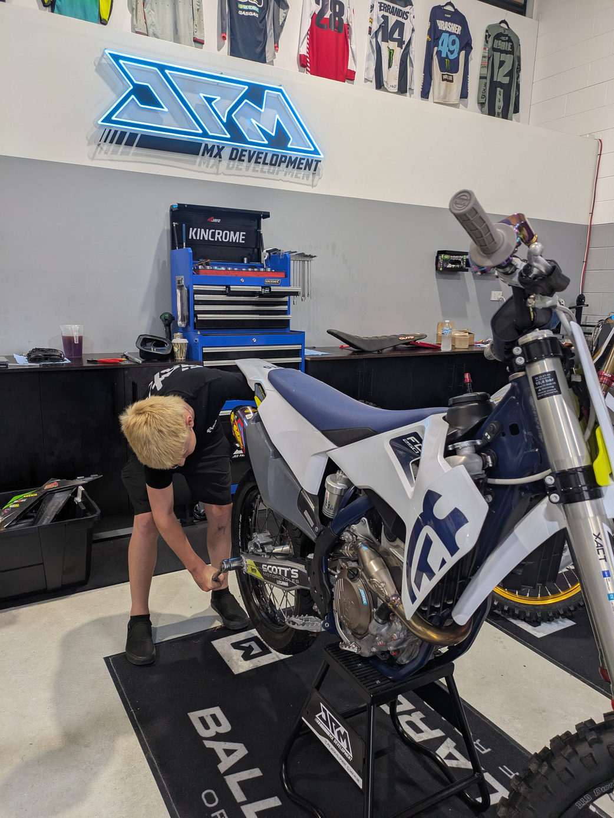
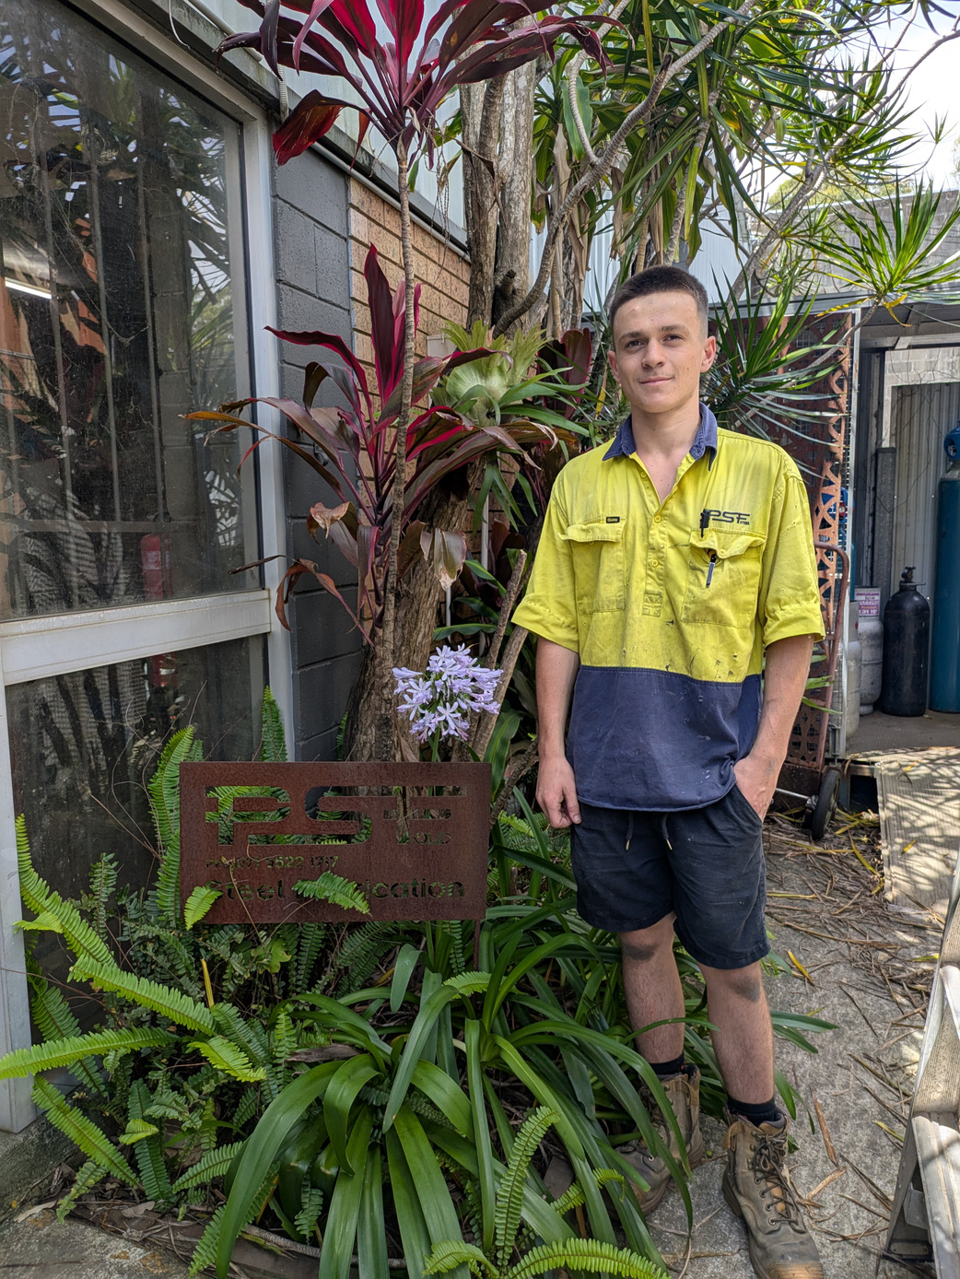
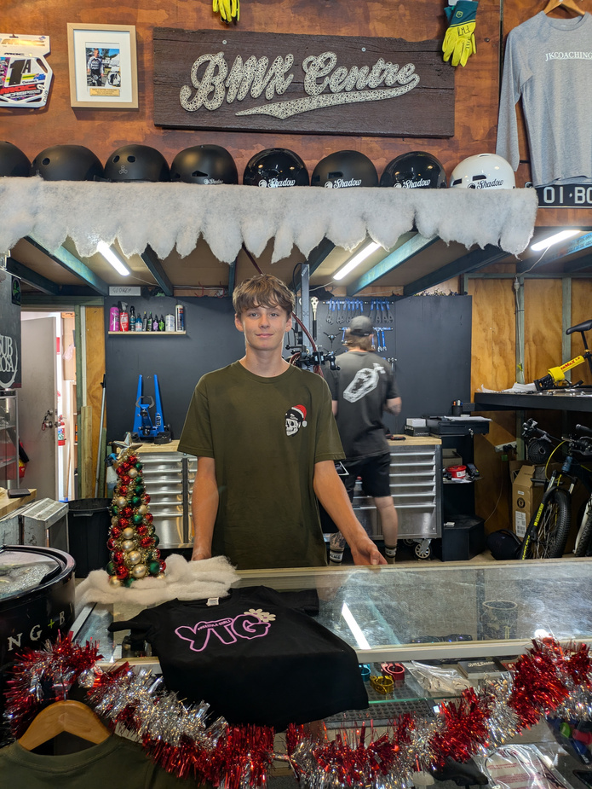
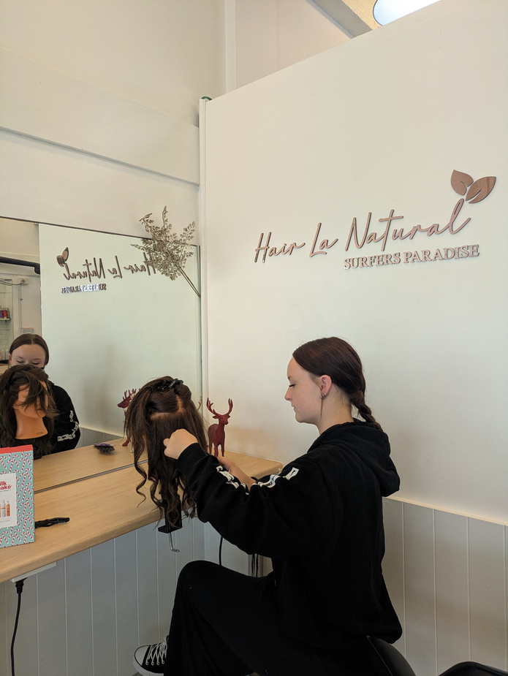
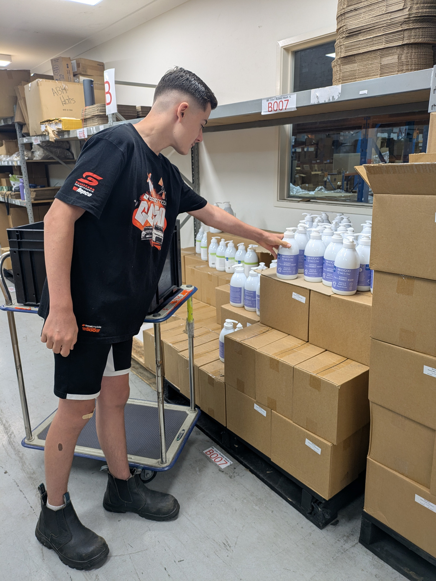
Learning Intentions:
Work Experience –
  what it is
  why it’s important
  how to get a placement
  key dates you need to know!

Slide 3





What is Work Experience?
A chance to:
Try different jobs
Learn real-world skills
Build Confidence
Explore your interests
Make career conections
Nixon
JPM MX Development

Slide 4
Why is Work Experience Important?
✅ Employers value experience
✅ Great for job & course applications
✅ Helps you figure out what suits you
✅ Can lead to paid work or a traineeship!
ambrose
PSF Steel
💡 This is your chance to get ahead!

Slide 5



True or False
But...
I already
have a job!
"If I already have a part-time job, I don’t need work experience."
"If I know what I want to do, work experience is a waste of time."
Every placement builds valuable skills.
💡 Work experience is all about learning, growing, and preparing for your future—no matter where you’re headed! 🚀

Slide 6
Top Employability Skills
using good body language
having a positive
attitude
Effort
being on time
having a strong
work ethic
willingness to learn
trustworthy
and reliable
communication

Slide 7
What You Need to Know
✔️ Must be at least 14 years old
✔️ Minimum 5 days in a real workplace
✔️You’re covered by Education Qld insurance
✔️You’re covered by Workers’ Compensation
✖️ No payment is allowed
jett
MooGoo Skin Care

Slide 8
How Do I Get a Placement?
💡 Step 1: Think about YOU - What interests you?
💬 Step 2: Talk to people - Family, teachers, friends
🔎 Step 3: Research local businesses - Start early!
The sooner you start, the better your chances of getting the placement you want!
Macy
The End Hairdressing

Slide 9
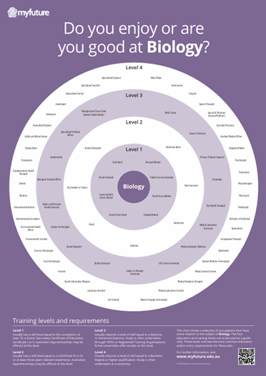
Talk to People Who Know
👨‍👩‍👧 Ask your family - What jobs have they done?
👩‍🏫 Talk to teachers - Especially in subjects you enjoy
💻 Use myfuture.edu.au ➡ Try Career Bullseyes
🌐 Search job specific skills – Do you need a qualification to get your dream job?
😊 Visit Mrs Hart in G12 for help anytime

Slide 10

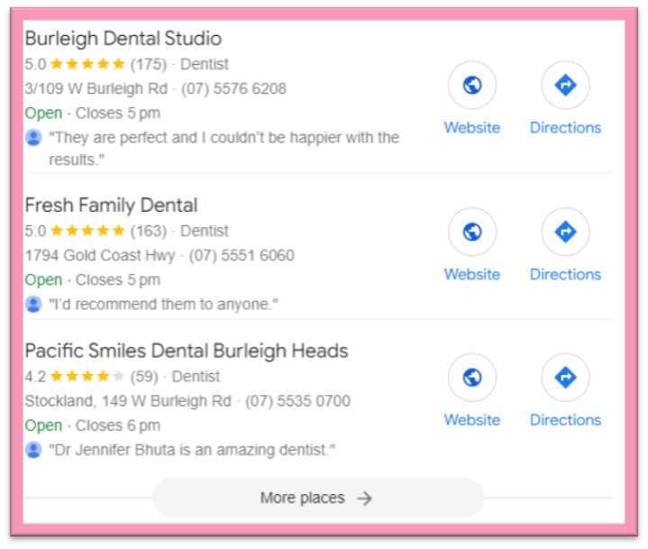
How to Search Locally
access
transport
Consider and
EG: I live in Burleigh Heads
I would search job + my location
search:
“Dentist Burleigh Heads”
3 businesses were found
= three potential work experience employers!
If there is nothing nearby, I’ll seach Miami, Palm Beach or Varsity - I can catch the bus there!

Slide 11
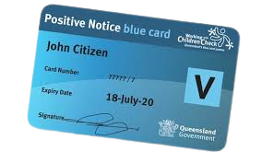
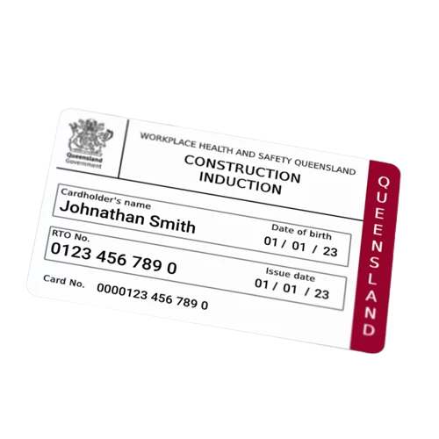
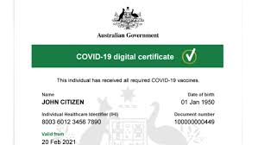
Job-Specific Requirements
Blue Card - For childcare or schools
White Card - For trades
Vaccination proof - For aged care or health
📌 If you need one of these, see Mrs Hart in G12 ASAP!

Slide 12

12 September - Collect Application Form
(Friday Week 9, Term 3)
10 October - Form DUE to Mrs Hart
(Friday Week 1, Term 4)
3 - 7 November - Agreement emailed via AdobeSign (Week 5, Term 4)
21 November - Final Day for agreement to be signed (Friday Week 7, Term 4)
Key Dates
Reminder: ❗ Miss a deadline? No placement.

Slide 13
It’s More Than Just a Week
🔍 Discover what excites you
🚀 Build workplace confidence
🔄 Understand what support you need
🎯 Learn your strengths
🌱 Grow your future
marcus
Resort News
💡 No matter what career you're considering, this is your chance to explore and grow!

Slide 14
Still Not Sure? That’s OK
Remember:
  Every job teaches you something
  It doesn’t have to be your dream job
  Focus on building skills
  Ask questions and seek help
  You’ve got this!
ivy
Miami Aquatic Centre
Don’t stress about finding the ‘perfect’ placement—what matters is what you learn and how you grow! 🚀

Slide 15
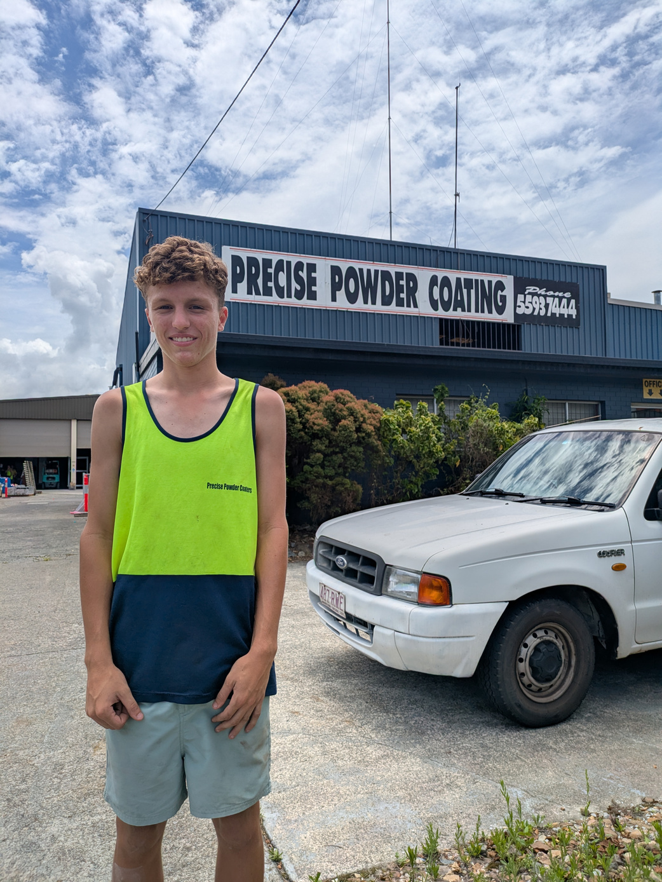
Ready to Start Your Journey?
Think about a career you’re curious about
Tell the person next to you:
“If I could try any job next term, I’d try...”
eli
Precise Powder Coaters
Work experience is your first step toward your future — let’s make it count!

